Slide 1

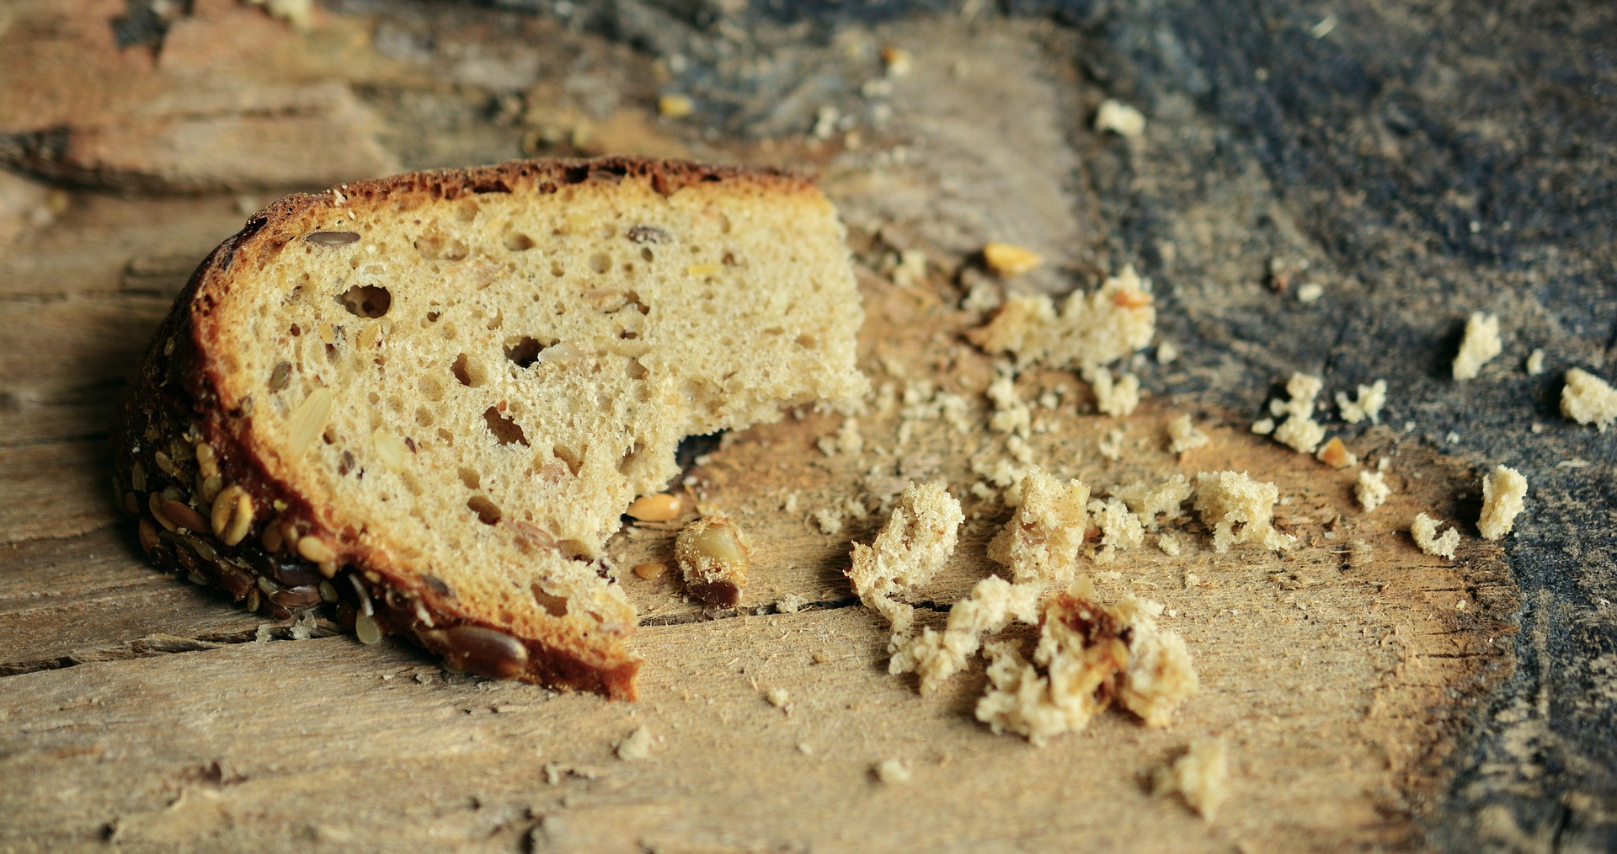
Climate Change
Hunger

Slide 2
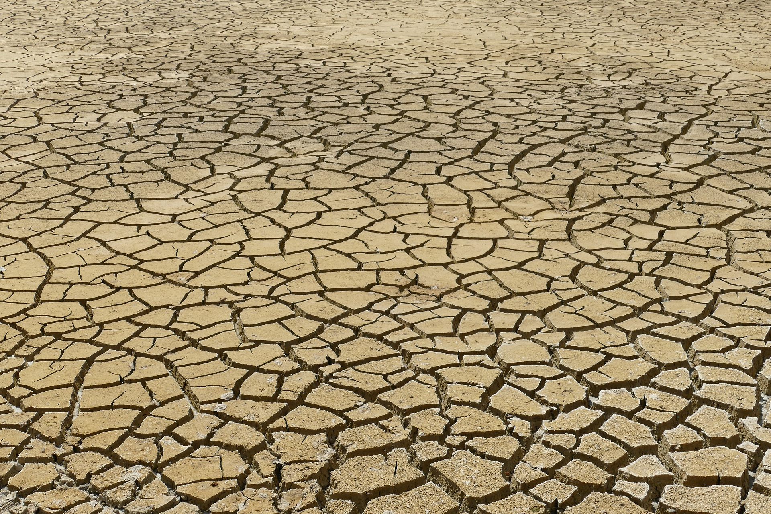

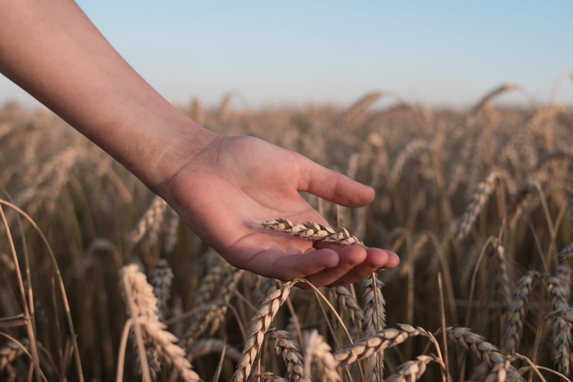
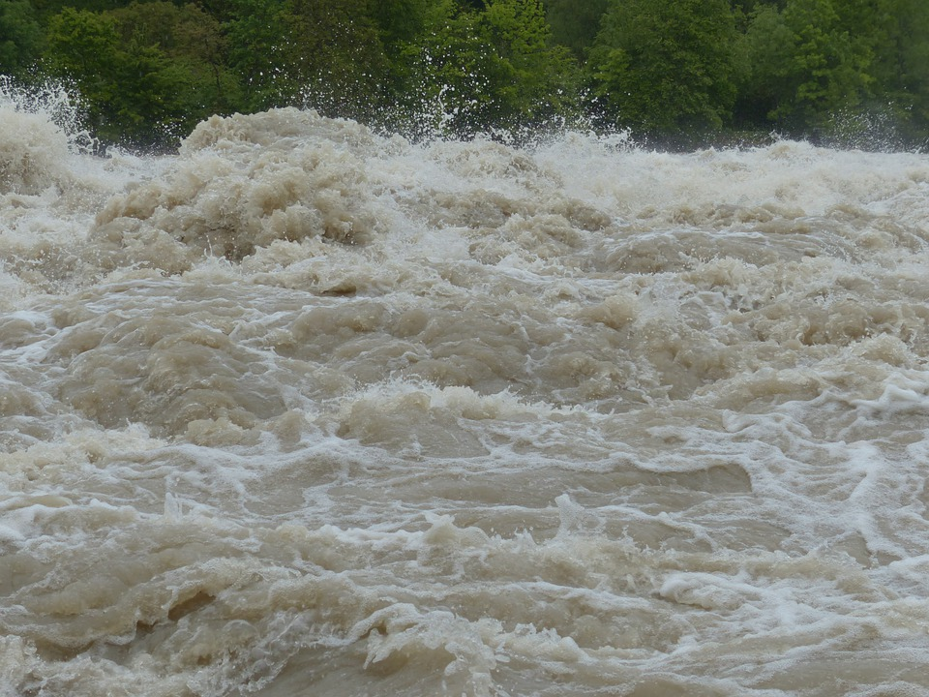
Complex
Machine Learning
Model / Understanding
Data-driven

Slide 3
Thesis Defense
Food Security and Climate Shocks The Resilience of Food Prices to Droughts in Malawi. A Machine Learning Approach.
Lena Blind

Slide 4

Research Questions
“How can a data-driven model be used to analyze the effect of drought on food prices in Malawi?”
How do food prices evolve per commodity, region, and in case of a drought event?
How does the spike in 2017-2020 vary by commodity?
How do Maize prices evolve according to the DMD?
How reliable are the insights for the statistical approach in the first two and the DMD approach taken in the third sub-question?

Slide 5
Data & Methodology

Slide 6
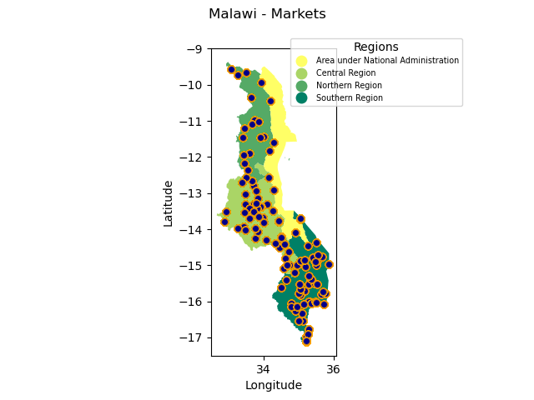
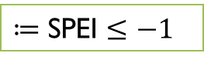
Data
$≔$ SPEI $≤−1$
Price Data
(WFP)
Market Coordinates (WFP)
Climate Data (SPEI)
Price Data with Market Coordinates (WFP)
Nearest Neighbor
Market & SPEI measure point
Preprocessing
Relevant subset of time (SPEI & WFP)
Merged Data (Prices & Climate)
One common inflation level
Remove extreme outliers

Slide 7



Data QUALITY & Research Strategy
Data quality (Price Data WFP)
Research Strategy
Commodity (all retail) | Share of missing prices | Number of missing prices | Number of all entries | Start Time (Y, M) | End Time (Y, M)
Beans Cassava Cowpeas Groundnuts (shelled) Maize Pigeon peas Rice | 72.45% 90.30% 94.79% 63.34% 54.15% 95.20% 75.79% | 8,053 11,668 4,544 4,453 15,386 3,350 9,986 | 11,115 12,922 4,794 7,030 28,413 3,519 13,176 | 2012, 06 2007, 02 2015, 05 2012, 06 2003, 01 2015, 05 2007, 01 | 2020, 04 2022, 03 2019, 07 2020, 04 2022, 03 2019, 07 2022, 03
All | 70.94 % | 57,440 | 80,969
Purely statistical approach
All commodities
Broad insights
Large share of missing data
Commodity | Share of missing data | Number of missing entries | Number of all entries | Start Time (Y, M) | End Time (T, Y)
Maize | 28.76% | 3,388 | 11,781 | 2003,01 | 2022,03
Machine Learning Approach
Smaller subset
Specific insights
Share of missing data < 30%

Slide 8
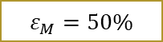
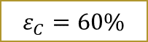
Ml dataset – Creation
$≔$ SPEI $≤−1$
Price Data
(WFP)
Market Coordinates (WFP)
Climate Data (SPEI)
Price Data with Market Coordinates (WFP)
Nearest Neighbor
Market & SPEI measure point
Preprocessing
Relevant subset of time (SPEI & WFP)
Preprocessing II
Drop too sparse commodities
Merged Data (Prices & Climate)
One common inflation level
$$ε_{C}=60\%$$
Drop too sparse markets
$$ε_{M}=50\%$$
Remove extreme outliers
Intrapolation of missing prices

Slide 9
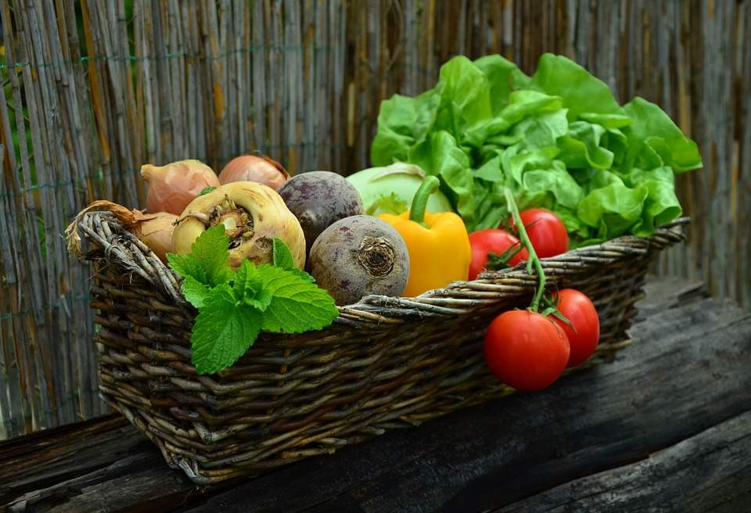
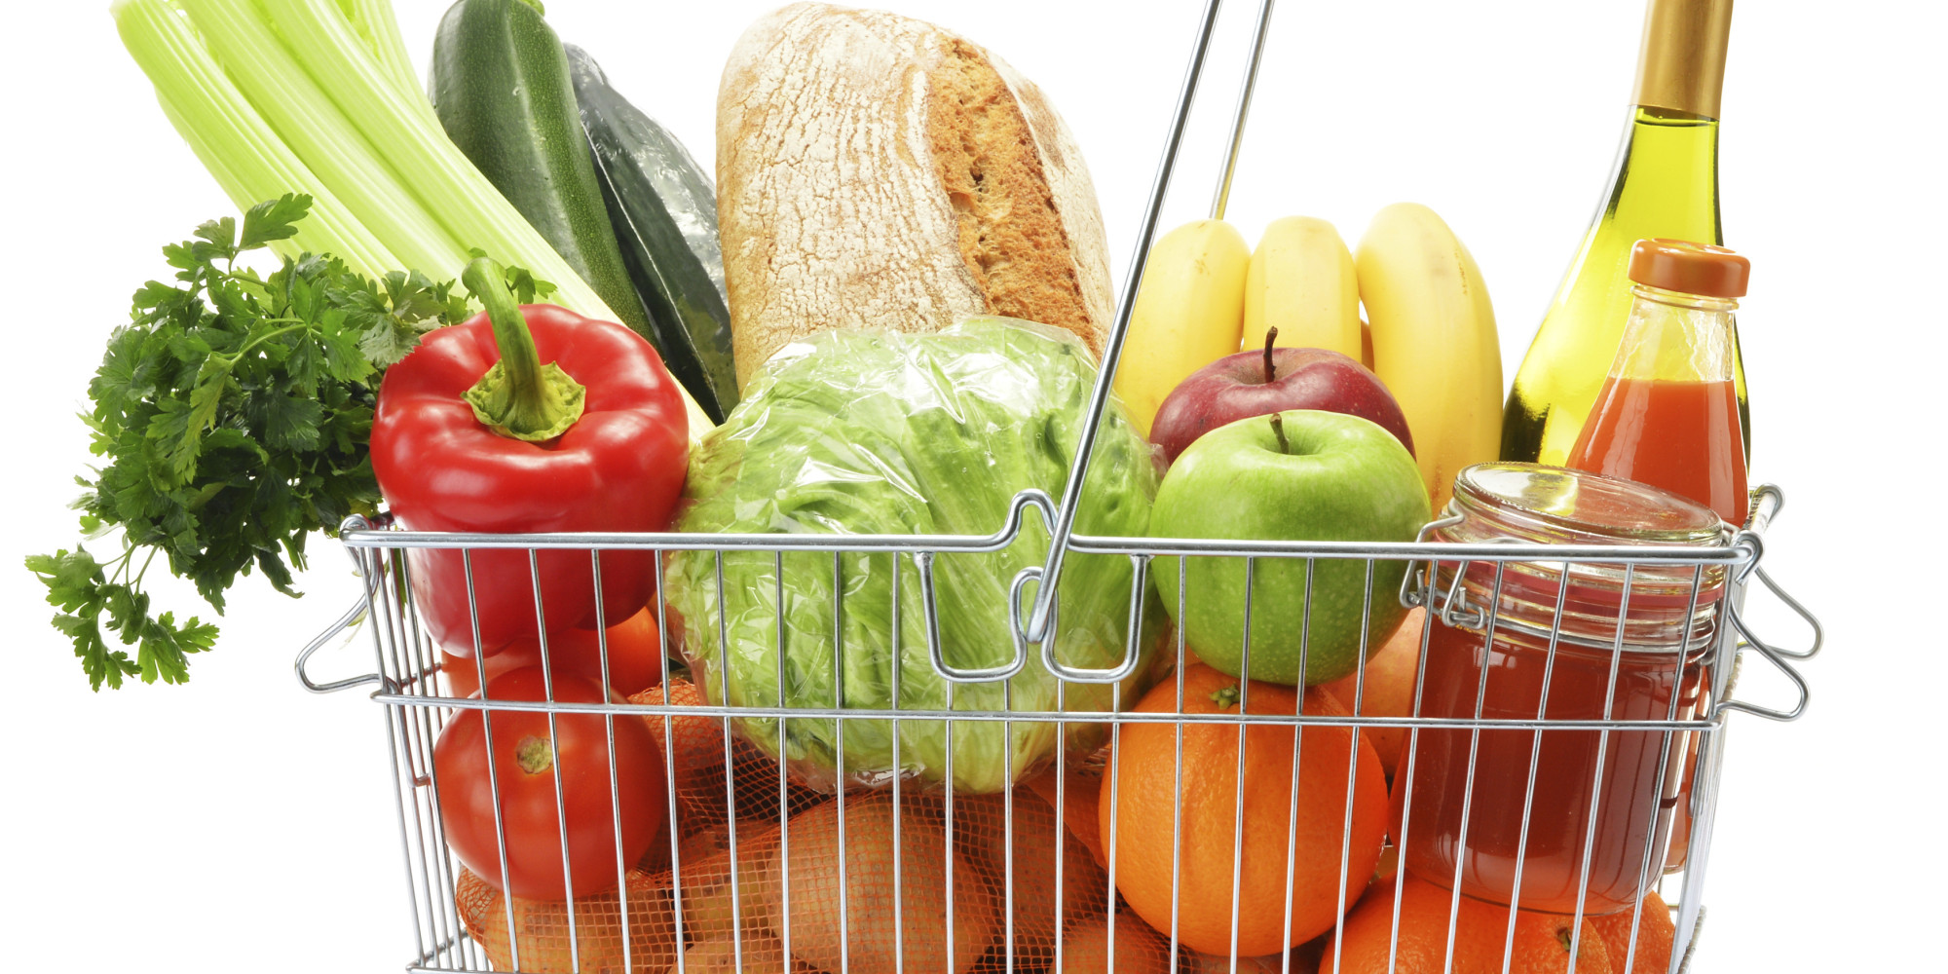
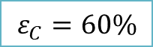
Preprocessing effect DROP COMMODITIES
Commodity (all retail) | Share of missing prices | Number of missing prices | Number of all entries
Beans Cassava Cowpeas Groundnuts (shelled) Maize Pigeon peas Rice | 72.45% 90.30% 94.79% 63.34% 54.15% 95.20% 75.79% | 8,053 11,668 4,544 4,453 15,386 3,350 9,986 | 11,115 12,922 4,794 7,030 28,413 3,519 13,176
All | 70.94 % | 57,440 | 80,969
Drop too sparse commodities
$$ε_{C}=60\%$$

Slide 10
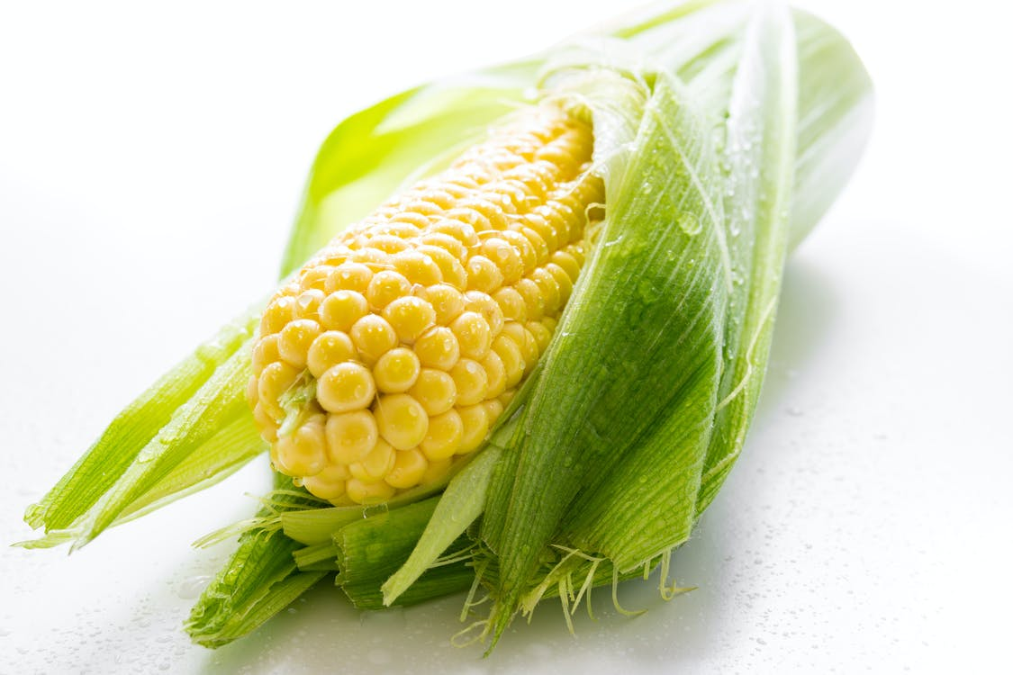
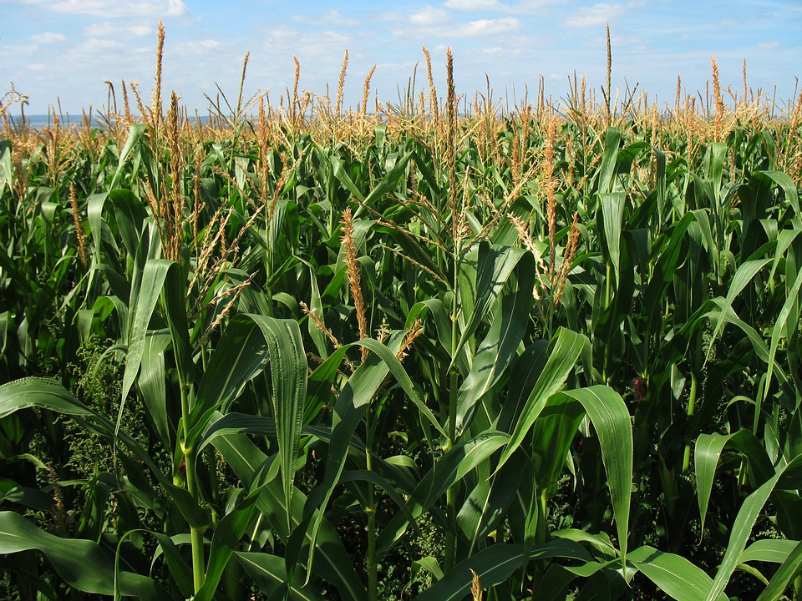
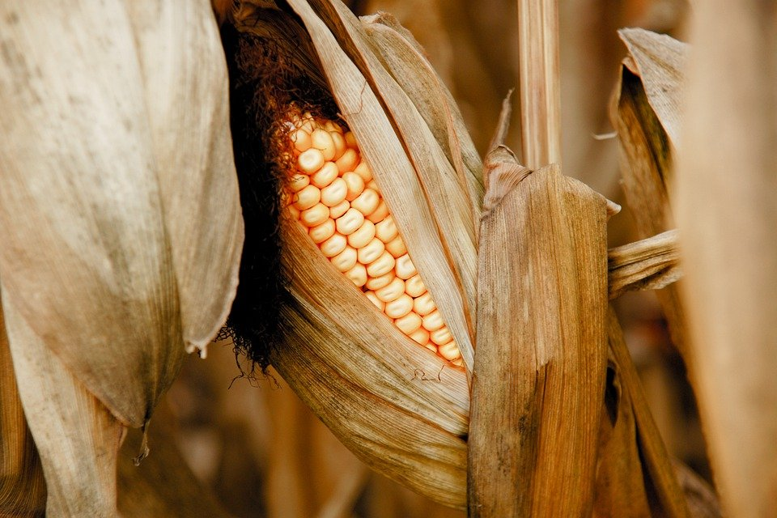
Preprocessing effect DROP COMMODITIES
Commodity (all retail) | Share of missing prices | Number of missing prices | Number of all entries
Beans Cassava Cowpeas Groundnuts (shelled) Maize Pigeon peas Rice | 72.45% 90.30% 94.79% 63.34% 54.15% 95.20% 75.79% | 8,053 11,668 4,544 4,453 15,386 3,350 9,986 | 11,115 12,922 4,794 7,030 28,413 3,519 13,176
All | 70.94 % | 57,440 | 80,969
Drop too sparse commodities
$$ε_{C}=60\%$$

Slide 11
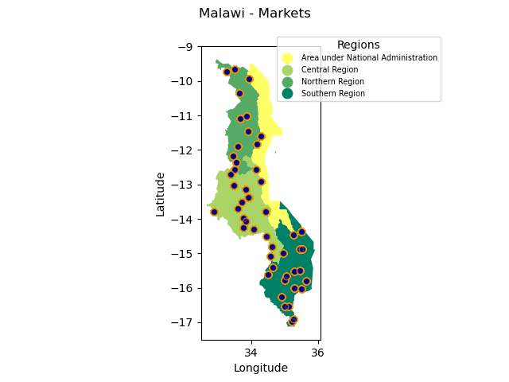
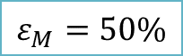
Data – DROP Markets
Drop too sparse markets
$$ε_{M}=50\%$$
123 markets
51 markets
Region | Share of missing data | Number of missing entries | Number of all entries | % Region all entries
Central Region | 53.24% | 5657 | 10,626 | 37.40%
Northern Region | 46.95% | 2169 | 4,620 | 16.26%
Southern Region | 57.42% | 7560 | 13,167 | 46.34%
All | 54.15% | 15,386 | 28,413 | 100.00%
Region | Share of missing data | Number of missing entries | Number of all entries | % Region all entries
Central Region | 28.73% | 1261 | 4389 | 37.25%
Northern Region | 28.75% | 797 | 2772 | 23.53%
Southern Region | 28.79% | 1330 | 4620 | 39.22%
All | 28.76% | 3,388 | 11,781 | 100.0%

Slide 12
Results I
Statistical approach
All commodities

Slide 13
Research Questions
“How can a data-driven model be used to analyze the effect of drought on food prices in Malawi?”
How do food prices evolve per commodity, region, and in case of a drought event?
How does the spike in 2017-2020 vary by commodity?
How do Maize prices evolve according to the DMD?
How reliable are the insights for the statistical approach in the first two and the DMD approach taken in the third sub-question?

Slide 14
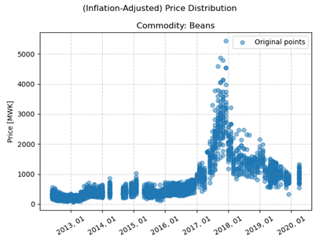
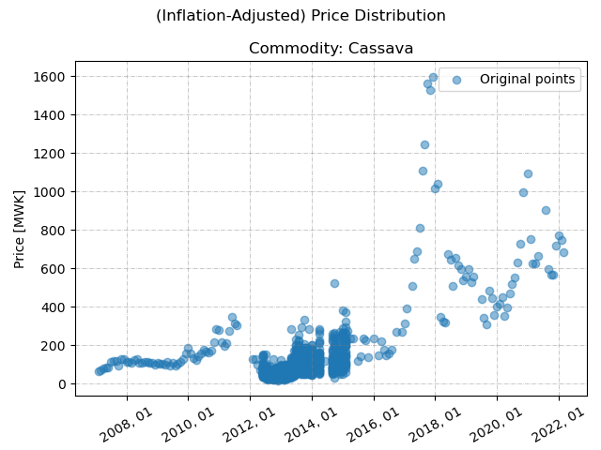
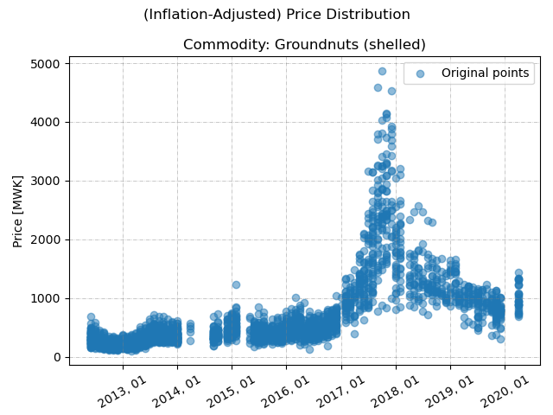
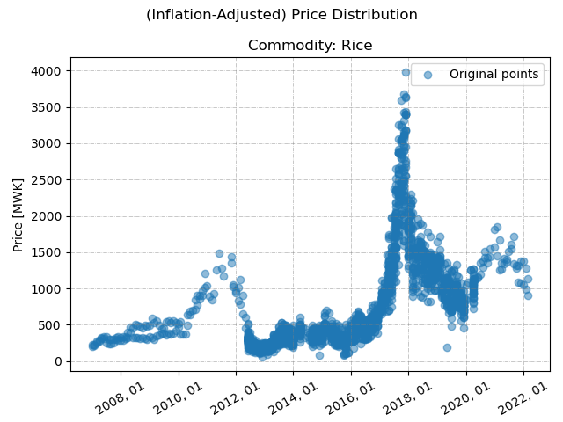
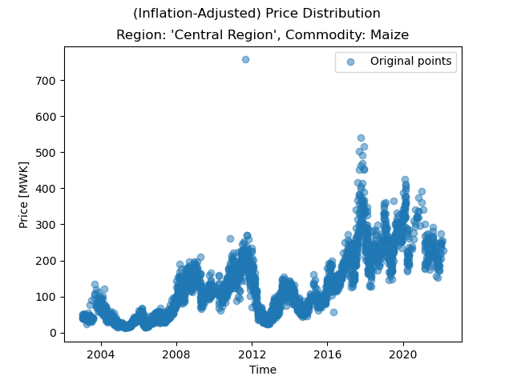
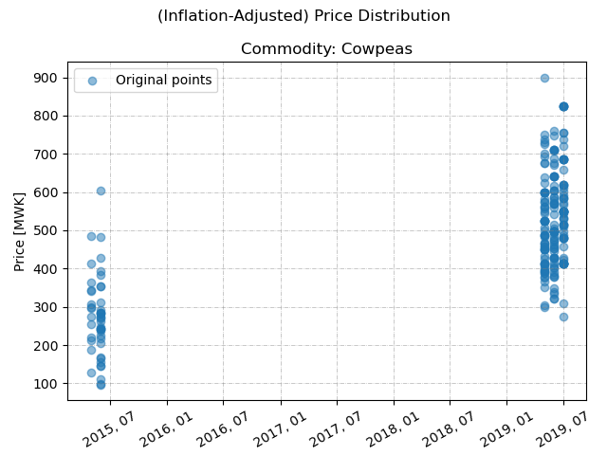
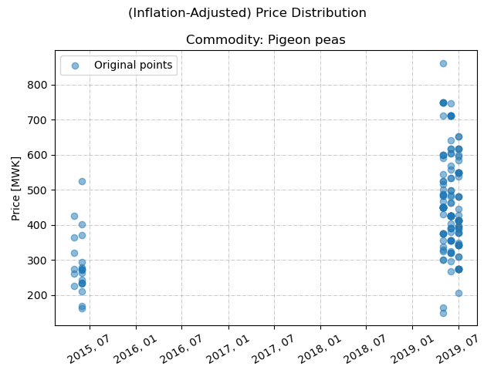
FLOW PER COMMODITY
Beans | Cassava | Groundnuts (shelled)
Rice | Maize | Cowpeas | Pigeon Peas

Slide 15
FLOW PER COMMODITY
Relatively similar behavior
Cowpeas, Pigeon Peas too sparse
Beans | Cassava | Groundnuts (shelled)
Rice | Maize | Cowpeas | Pigeon Peas

Slide 16
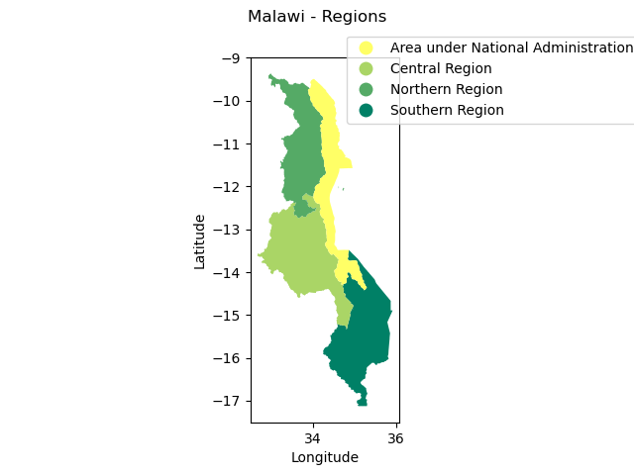
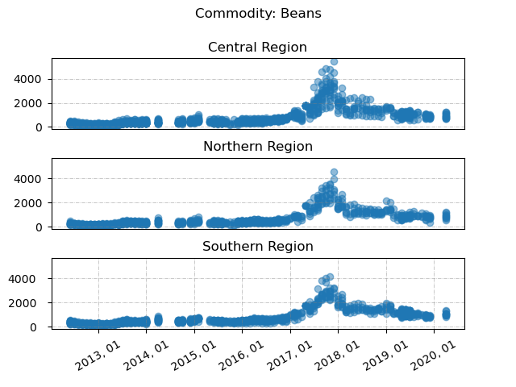
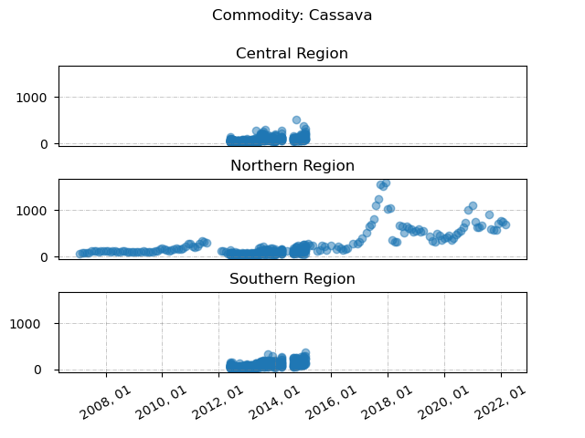
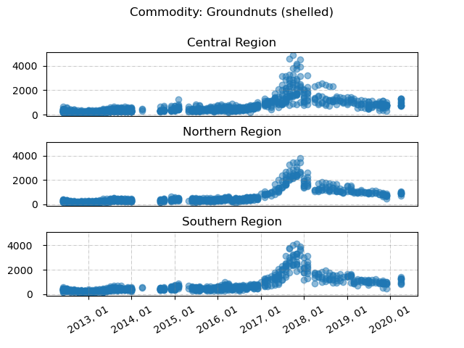
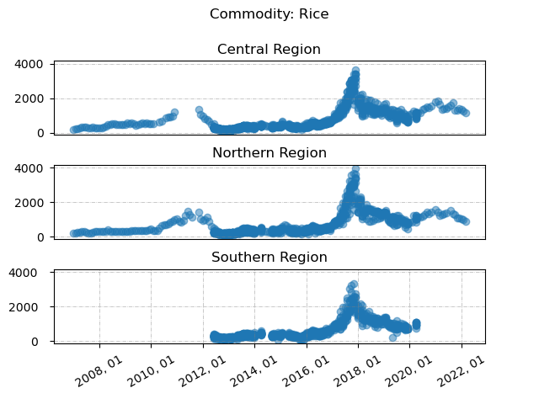
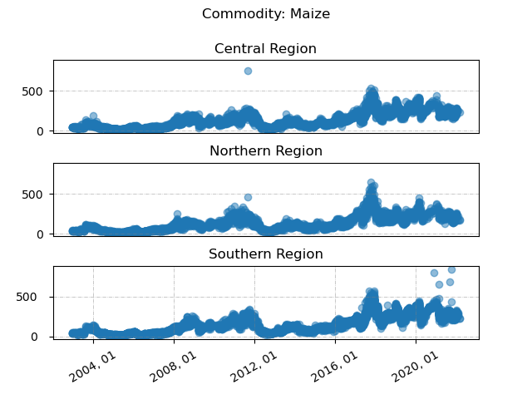
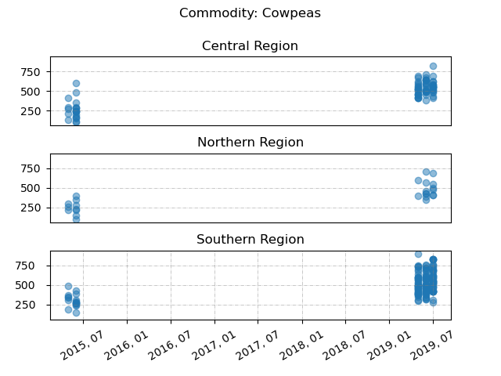
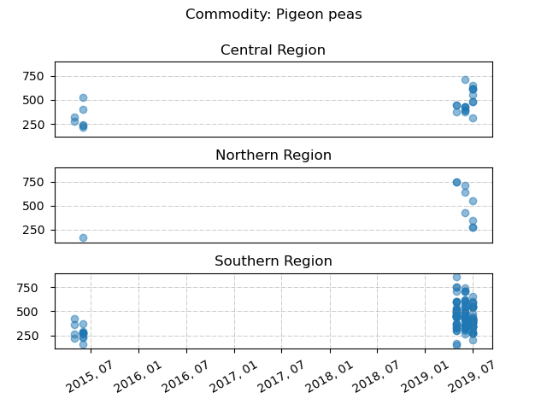
FLOW PER Region
No considerable regional effect
Tendency highest prices (desc.):
Central, Northern, Southern Region
Beans | Cassava | Groundnuts (shelled)
Rice | Maize | Cowpeas | Pigeon Peas

Slide 17
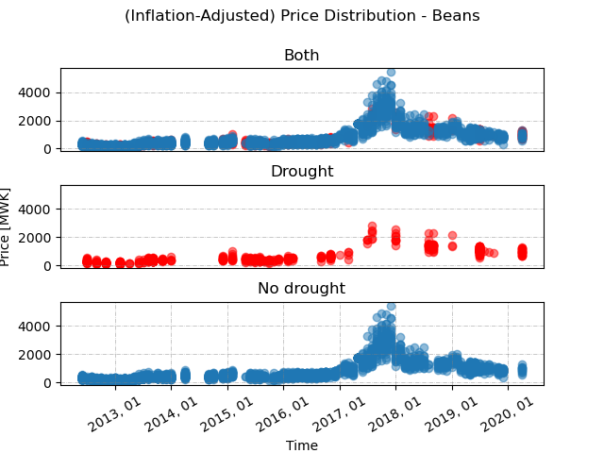
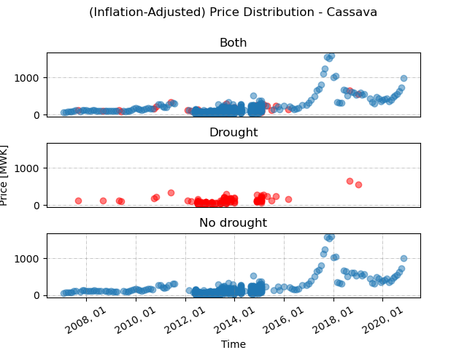
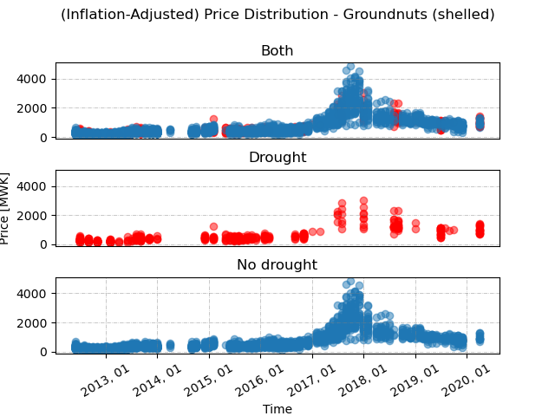
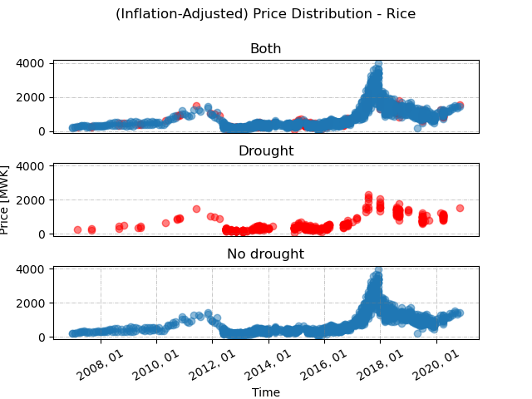
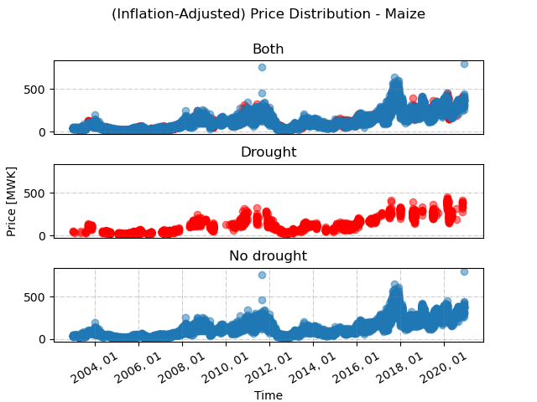
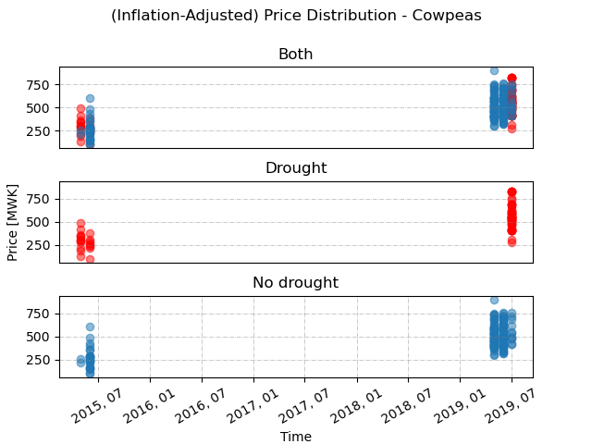
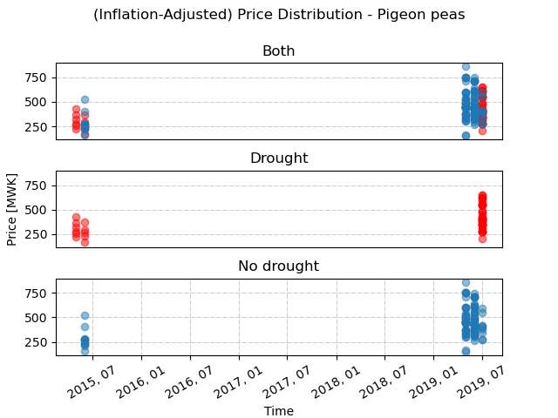
FLOW PER Drought
Spikes highest for non-drought case
Delayed effect?
Beans | Cassava | Groundnuts (shelled)
Rice | Maize | Cowpeas | Pigeon Peas

Slide 18
Research Questions
“How can a data-driven model be used to analyze the effect of drought on food prices in Malawi?”
How do food prices evolve per commodity, region, and in case of a drought event?
How does the spike in 2017-2020 vary by commodity?
How do Maize prices evolve according to the DMD?
How reliable are the insights for the statistical approach in the first two and the DMD approach taken in the third sub-question?

Slide 19
What happened in 2017?
Armyworm pest
Drought
Floods (as of 03 2017)
State of national disaster
(December 2017)
NO EXPORT

Slide 20
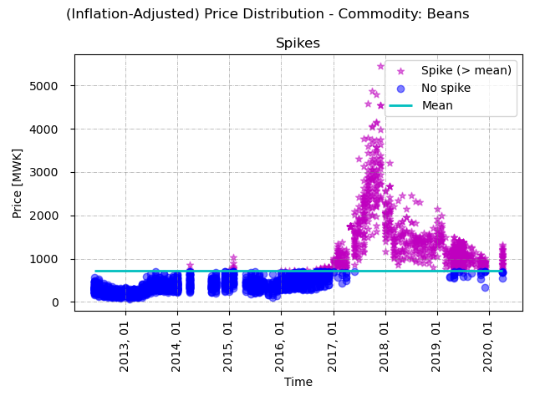
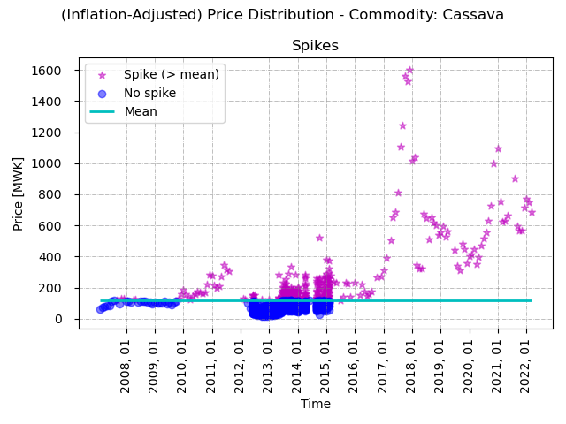
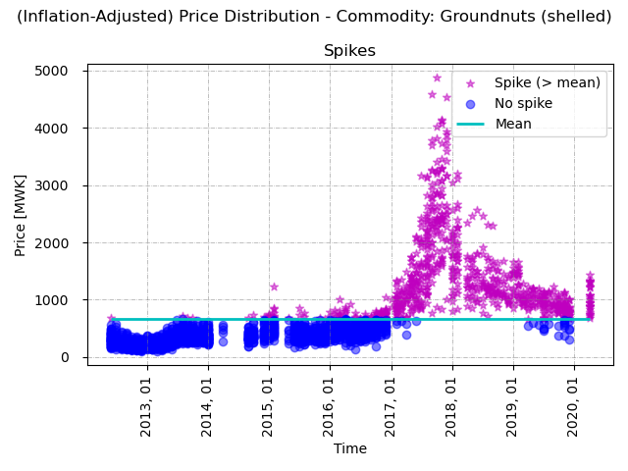
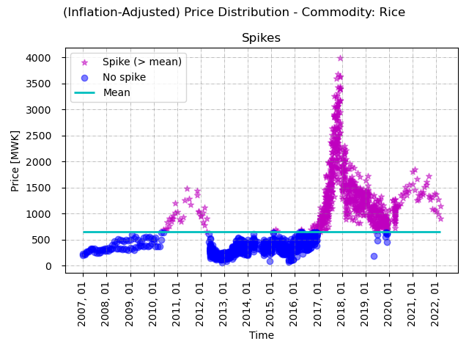
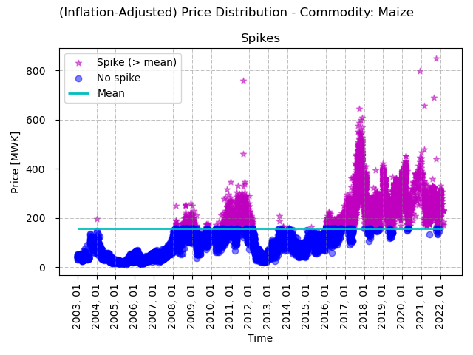
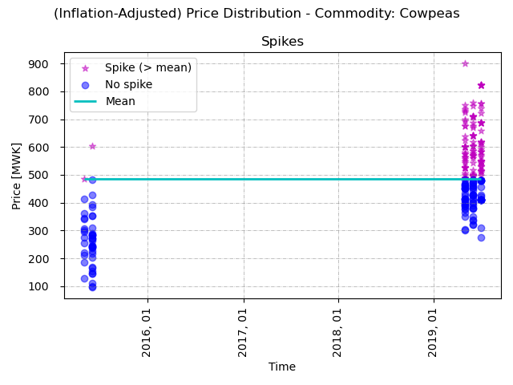
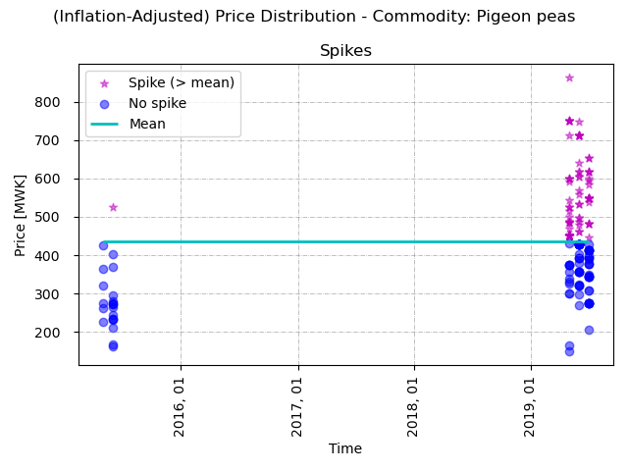
EVOLUTION SPIKE
On-/offset relatively similar: 2017/01 – 2020/01
Earlier offset Maize: 2018/06
Height of Spikes between 4.07 – 13.75 * Mean
13.75 * Mean
Beans | Cassava | Groundnuts (shelled)
7.63 * Mean
6.40 * Mean
6.09 * Mean
1.86 * Mean
1.98 * Mean
Rice | Maize | Cowpeas | Pigeon Peas
4.07 * Mean

Slide 21
Results II
DMD approach
Only maize

Slide 22
Research Questions
“How can a data-driven model be used to analyze the effect of drought on food prices in Malawi?”
How do food prices evolve per commodity, region, and in case of a drought event?
How does the spike in 2017-2020 vary by commodity?
How do Maize prices evolve according to the DMD?
How reliable are the insights for the statistical approach in the first two and the DMD approach taken in the third sub-question?

Slide 23

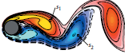
Dynamic mode decomposition (DMD)
Machine Learning
Time

Slide 24
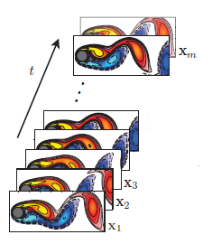
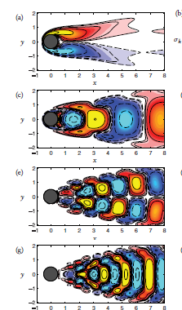
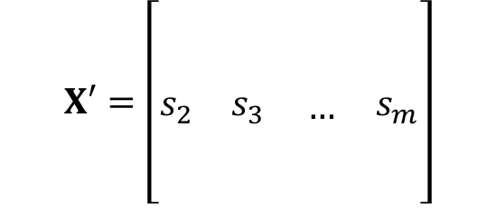

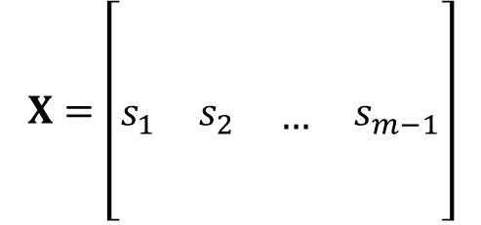



Dynamic mode decomposition (DMD)
Time Series
Organize data
Regression
Dominant patterns
$$X=\left[\begin{matrix} & & \begin{matrix} & \end{matrix} \\ \begin{matrix} \\ s_{1}\end{matrix} & \begin{matrix} \\ s_{2}\end{matrix} & \begin{matrix}\begin{matrix} \\ …\end{matrix} & \begin{matrix} \\ s_{m−1}\end{matrix}\end{matrix} \\ \begin{matrix} \\ \end{matrix} & \begin{matrix} \\ \end{matrix} & \begin{matrix}\begin{matrix} & \end{matrix} \\ \begin{matrix} & \end{matrix}\end{matrix}\end{matrix}\right]$$
$$A=X´X^{†}$$
Model A
$$X′=\left[\begin{matrix} & & \begin{matrix} & \end{matrix} \\ \begin{matrix} \\ s_{2}\end{matrix} & \begin{matrix} \\ s_{3}\end{matrix} & \begin{matrix}\begin{matrix} \\ …\end{matrix} & \begin{matrix} \\ s_{m}\end{matrix}\end{matrix} \\ \begin{matrix} \\ \end{matrix} & \begin{matrix} \\ \end{matrix} & \begin{matrix}\begin{matrix} & \end{matrix} \\ \begin{matrix} & \end{matrix}\end{matrix}\end{matrix}\right]$$
$$X^{′}≈AX$$
$u_{i}$ DMD modes (eigenvectors)
Eigendecomposition
$$Au_{i}=λ_{i}u_{i}$$

Slide 25











DMD Results (TIME) – 95% Var.
Original Snapshot Matrix $S$
DMD Mode(s) $φ_{j}$
DMD eigenvalue(s) $λ_{j}$
DMD Components
Reconstructed/ Predicted Matrix
Evolution in time
DMD dynamics $λ_{j}^{k}b_{j}$
$$x_{t+1}=A^{t}x_{0}=VΛ^{t}V^{−1}x_{0}$$
$$x_{t+1}≈ΦΛ^{t}Φ^{†}x_{0}:=ΦΛ^{t}b_{t}$$
$$= \sum_{j=1}^{τ}{ϕ_{j}λ_{j}^{t}}b_{j}$$

Slide 26





DMD Results (Space) – 95% Var.
Original Snapshot Matrix $S$
DMD Mode(s) $φ_{j}$
DMD eigenvalue(s) $λ_{j}$
DMD Components
Reconstructed/ Predicted Matrix
Evolution in time
DMD dynamics $λ_{j}^{k}b_{j}$
$$x_{t+1}=A^{t}x_{0}=VΛ^{t}V^{−1}x_{0}$$
$$x_{t+1}≈ΦΛ^{t}Φ^{†}x_{0}:=ΦΛ^{t}b_{t}$$
$$= \sum_{j=1}^{τ}{ϕ_{j}λ_{j}^{t}}b_{j}$$

Slide 27
RELIABILITY
Limitations of each approach

Slide 28
Research Questions
“How can a data-driven model be used to analyze the effect of drought on food prices in Malawi?”
How do food prices evolve per commodity, region, and in case of a drought event?
How does the spike in 2017-2020 vary by commodity?
How do Maize prices evolve according to the DMD?
How reliable are the insights for the statistical approach in the first two and the DMD approach taken in the third sub-question?

Slide 29


Limitations DMD Approach
It’s just a model …
Data Quality & Quantity
DMD I (Time) - Abs. Error
DMD II (Space) - Abs. Error
Only Maize (30% missings)
Min. Error | Mean Error | Max. Error
0.0008 | 97.1100 | 718.8212
Min. Error | Mean Error | Max. Error
0.00 | 16.42 | 557.63
Small sample size, <50% of orig. sample
Low accuracy, not useful for predictions
Higher accuracy, but not useful for predictions (dimensionality)
Not all markets & commodities represented

Slide 30



Limitations Stat. Approach
It’s just a model …
Data Quality & Quantity
Simplification of drought events
Other omitted factors
NO EXPORT
Large gaps, low data density
No time delay in Droughts
No differentation drought intensity
conflict, flood, armyworm plague, socio-economic factors, humanitarian interventions, Maize ban, trade,…
SPEI as an index aggregation in itself

Slide 31
How can we improve?
Policy recommendations

Slide 32





Recommendations
Improve data quality, increase data quantity & collaborate
Monitor & ensure adequacy of cash-transfers
Resilience: Climate-smart agriculture
Gender & Youth-sensitive policies
Fewer data gaps
Higher data density
Collaboration & Data Sharing (FAO)
Large variability can endanger adequate protection
In-kind transfers logistically difficult during raining season in Malawi
Intercropping
Financial incentives (e.g. reinvest subsidies for Maize fertilizer)
Women account for 80% of household food production
Women & children especially vulnerable
Prevention of GBV and child marriage

Slide 33
Questions?
Lena Blind

Slide 34




DMD Results (TIME) – Optimal (9)
Original Snapshot Matrix $S$
DMD Mode(s) $φ_{j}$
DMD eigenvalue(s) $λ_{j}$
DMD Components
Reconstructed/ Predicted Matrix
Evolution in time
DMD dynamics $λ_{j}^{k}b_{j}$
$$x_{t+1}=A^{t}x_{0}=VΛ^{t}V^{−1}x_{0}$$
$$x_{t+1}≈ΦΛ^{t}Φ^{†}x_{0}:=ΦΛ^{t}b_{t}$$
$$= \sum_{j=1}^{τ}{ϕ_{j}λ_{j}^{t}}b_{j}$$

Slide 35










DMD Algorithm
$$A=X´X^{†}$$
$$A∈ ℂ^{m×m}$$
Reduced SVD
$$X^{†}=\hat{U}{\hat{Σ}}^{−1}{\hat{V}}^{∗}$$
$$X=\hat{U}\hat{Σ}{\hat{V}}^{∗}$$
Pseudoinverse
$$Σ^{†}=diag(\frac{1}{σ_{1}}, …\frac{1}{σ_{r}}, 0, …0)$$
Lower dimensional subspace
$$\tilde{A}={\hat{U}}^{∗}A\hat{U}$$
$$={\hat{U}}^{∗}X′\hat{V}{\hat{Σ}}^{−1}$$
Compute DMD eigenvalues
$$\tilde{A}W=WΛ$$
Reconstruct high-dimensional DMD modes
$$Φ=\hat{U}W$$
$$Φ=X^{′}\hat{V}{\hat{Σ}}^{−1}W$$

Slide 36




Geometrical interpretation SVD
$U, V$orthogonal
rotary-reflection
$Σ$diagonal
scaling
$$A=UΣV^{T}$$
Hyperellipse
$σ_{i}$ lengths semiaxes
$u_{i}$ directions semiaxes

Slide 37







Relation SVD to Eigenproblem
Correlation matrices
$σ_{i}^{2}$ eigenvalues of $A^{T}A$($AA^{T}$respectively)
Proof
A regular $⇒U=V, Σ=Λ$
$$A^{T}A=\left(VΣ^{T}U^{T}\right)UΣV^{T}$$
$$=VΣ^{T}U^{T}UΣV^{T}$$
$$=VΣ^{T}ΣV^{T}$$
$$I$$
$$Σ_{n}^{2}$$
$$=VΣ_{n}^{2}V^{−1}$$
Generalization of the eigendecomposition

Slide 38






Adjustment of food prices to one inflation level
Algorithm 1: Adjustment of food prices to same inflation level
$M_{y, m}= \frac{i_{\tilde{y}, \tilde{m}}}{i_{y, m}}$
${\tilde{P}}_{y, m}=M_{y, m}∗P_{y, m}$
Prices $P$
Inflation $i$
multiplier $M$
$\tilde{y}, \tilde{m}$ Base year, base month (2022,4)
$$i_{\tilde{y}, \tilde{m}}=19.5\%$$

Slide 39
Sources IMAGES
https://pixabay.com/images/id-2254711/
https://pixabay.com/images/id-1908436/
https://pixabay.com/images/id-3544048/
https://pixabay.com/images/id-2542308/
https://pixabay.com/images/id-4282884/
https://pixabay.com/images/id-392707/
https://pixabay.com/images/id-123200/
https://pixabay.com/images/id-752153/
https://pixabay.com/images/id-1935/
https://pixabay.com/images/id-1179119/
https://www.pexels.com/de-de/foto/gelber-mais-547264/
UN World Food Programme (WFP)

